Slide 1
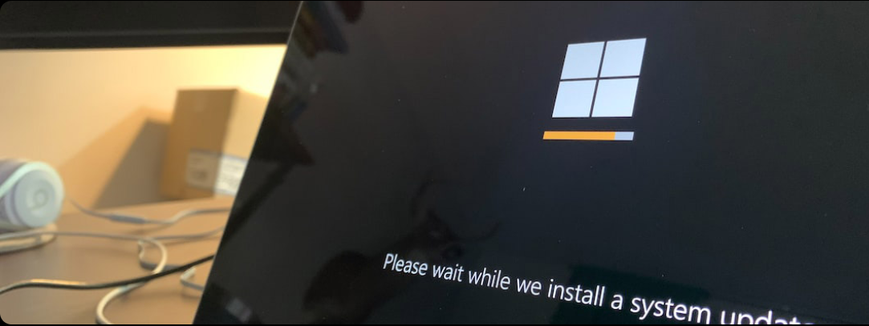
Operating Systems
Introduction

Slide 2
Course Topics
Overview of Operating Systems
Goals
Types of Operating Systems
Next Gen Operating Systems
Functions
Components of Computer Systems
Functions of Operating Systems

Slide 3
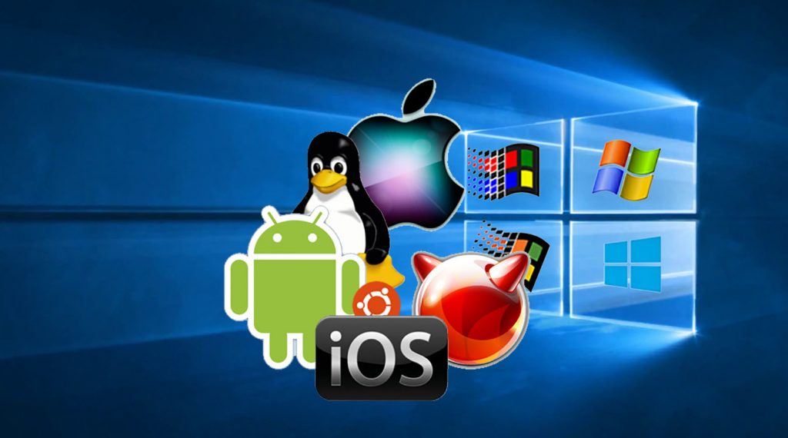
Flavours of OS?

Slide 4
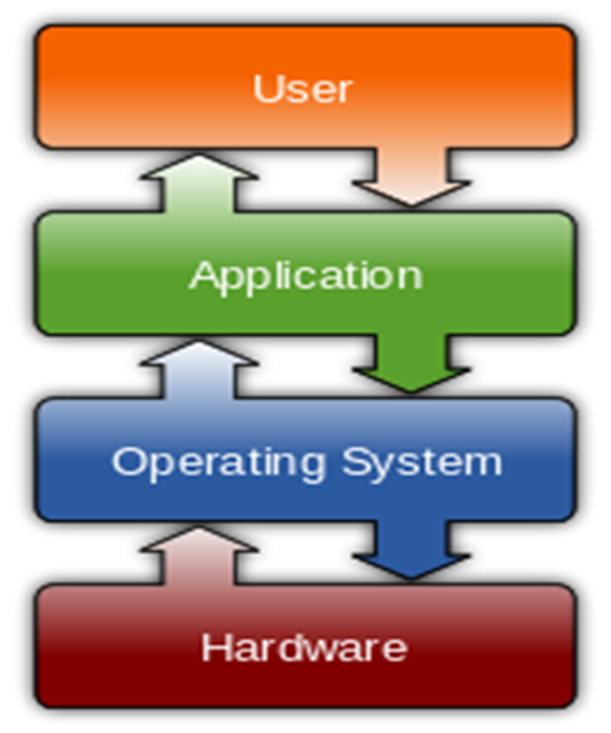
OS – The Resource Manager

Slide 5
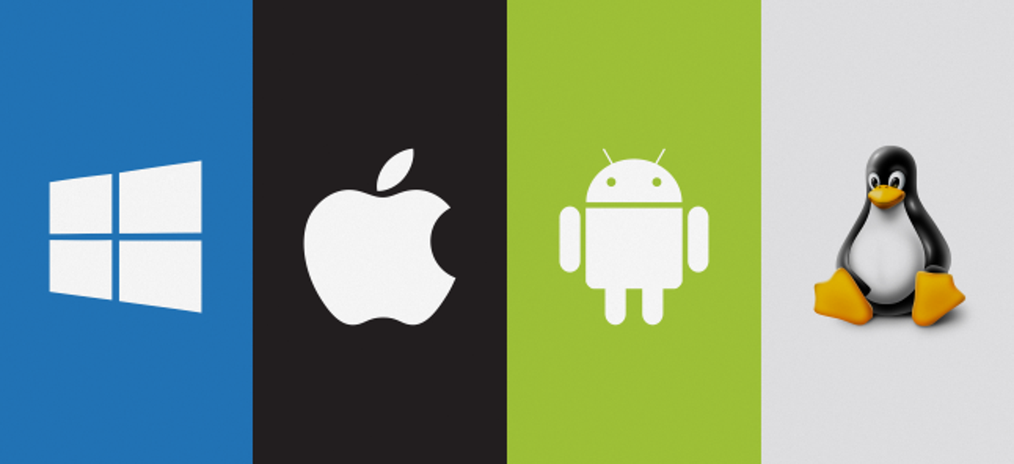
A System software
Supports a computer’s basic functions, such as scheduling tasks and controlling peripherals.
Act as an intermediary between the user of a computer and computer hardware.
Controls and coordinates overall resources of the system.

Slide 6


Why Study Operating Systems?
Makes you Better programmer – Write Efficient, Secure and Stable code
Gateway to Advanced Fields – Cyber Security, Cloud Computing, Embedded Systems, AI/ML

Slide 7


Why Study Operating Systems?
Industry & Interview Relevance: Google, Amazon, Microsoft interviews
Builds Your Engineering Mindset: Think in terms of resources and constraints

Slide 8
Goals of Operating Systems
Convenience (User-Friendly Operation)
Efficiency – Optimal use of resources
Ability to Evolve – Flexibility and Portability

Slide 9
Types of Operating Systems
Multi User Operating System
Multi Tasking Operating System
Multi Programming Operating System
Multi Processing Operating System
Real Time Operating Systems

Slide 10

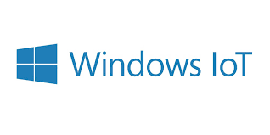






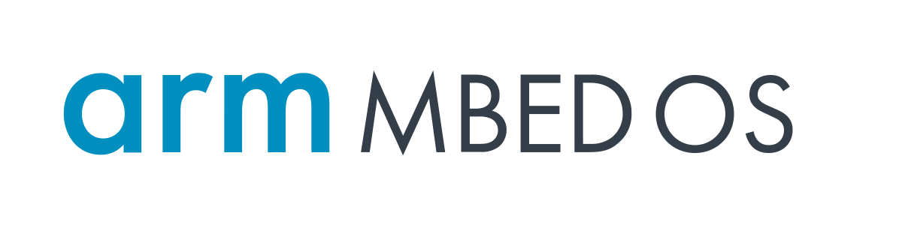
Next Gen Operating Systems
OS for IoT systems

Slide 11
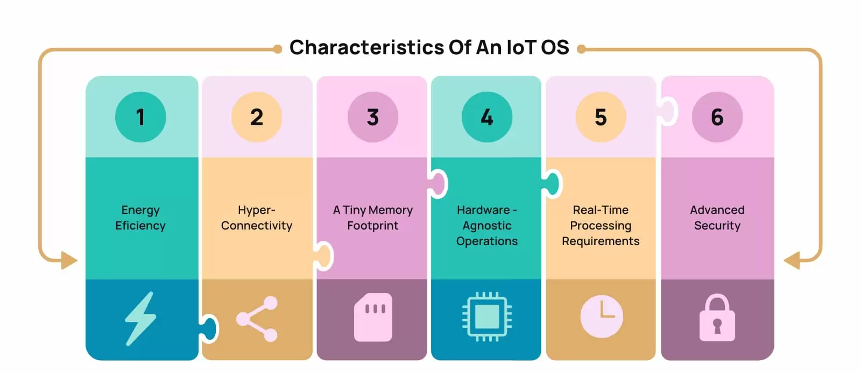
Next Gen Operating Systems
OS should consume minimal memory, processing power, onboard storage, and other computing resources while performing its tasks.

Slide 12
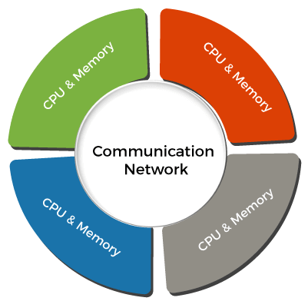
Next Gen Operating Systems
Distributed OS
Distributed systems use many central processors to serve multiple real-time applications and users.
As a result, data processing jobs are distributed between the processors.

Slide 13


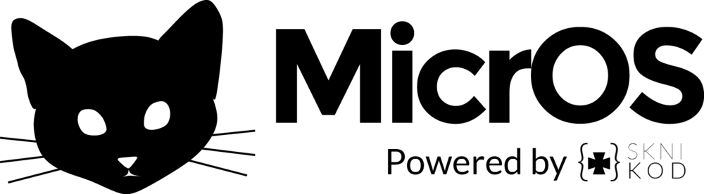

Next Gen Operating Systems

Slide 14
Components of Computer System

Slide 15
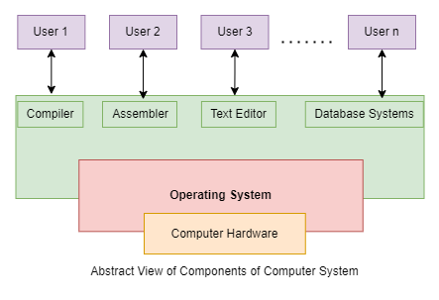

Slide 16
Functions of Operating Systems

Slide 17
Functions of OS
Process Management
Memory Management
Device Management
File Management
User Management

